Slide 1



ABAP on Hana s/4 Hana Training
Day 16
contact@anubhavtrainings.com

Slide 2

Agenda – Day 16
Use Case
Flow of Use Case
Implementing Use Case
Creating Fiori App on top of CDS View
Defining Metadata Extension
Describing UI Annotations

Slide 3
Use Case
Aviation industry changed a lot and hard hit by pandemics. They are allowed to perform flight operations with COVID safety norms. As per aviation ministry most of the activities should be contact less. Which includes the luggage, boarding, sitting arrangement, aircraft sanitization and food deliveries. Now due to pandemic, the loading of food and beverages inside a flight is also changing.
My Customer asked me to develop a solution which can be used by food manager on the floor with his/her tablet to check the upcoming flights and assign the food items. A delivery manager thus check the assignment and approves it. On approval, the same will be picked by crew members from backyard of airport.
We are already on S/4HANA and we have following needs
A Fiori App which should be fast and accessible on tablet to view all the flights
User should be able to search the flights based on CARRID, CONNID
We should be able to create new entries for flight and assign meal for them
Also solution should allow Update and delete of flight meal records
Finally, An approval process is also required to approve flight meals assigned by food manager on floor.

Slide 4
Flow of Use Case
Metadata Extension CDS View.
Consumption CDS View.
Table – ZOFT_MEALS.
Draft Table - ZOFT_JUL_MEAL.
ZOFT_JUL_MEAL
ZOFT_MEALS
ZATS_CDS_BOPF
ZATS_MED_BOPF

Slide 5
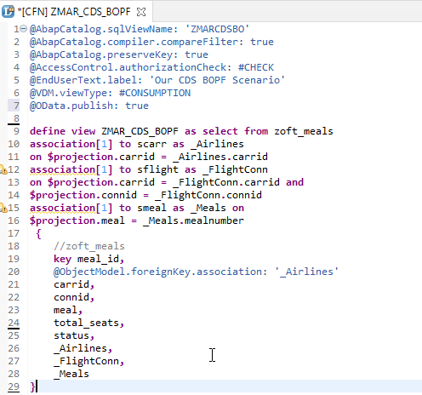
Exercise
CDS View Code
OData Exposure

Slide 6
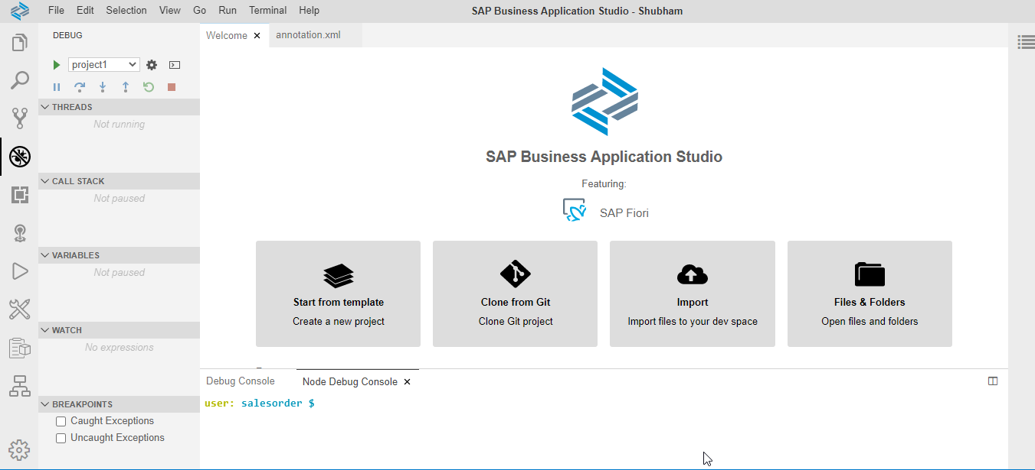
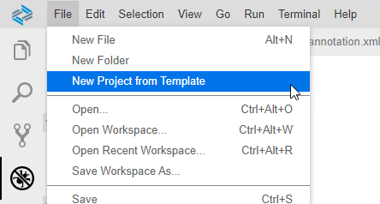
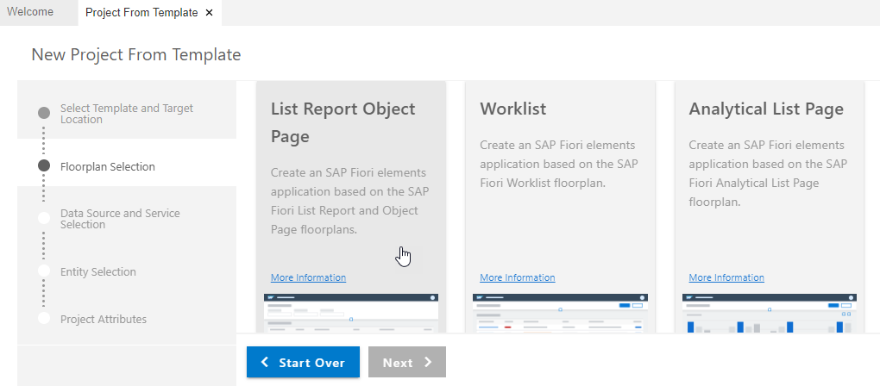
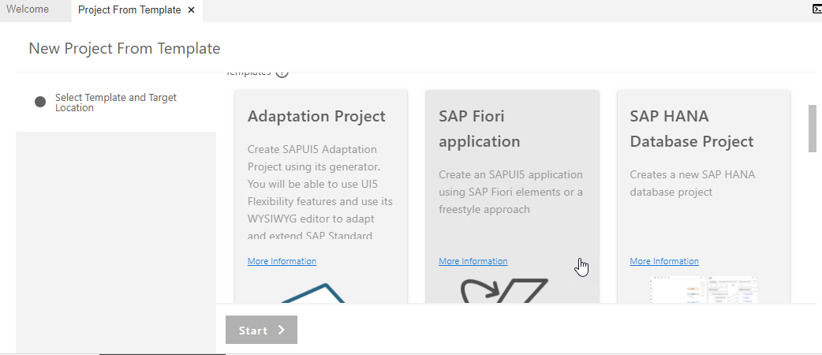
Create Fiori App with Template on BAS
Step 1. Open Business Application Studio.
Step 4. Choose List Report Object Page & Next.
Step 3. Click on SAP Fiori application & Next.

Slide 7
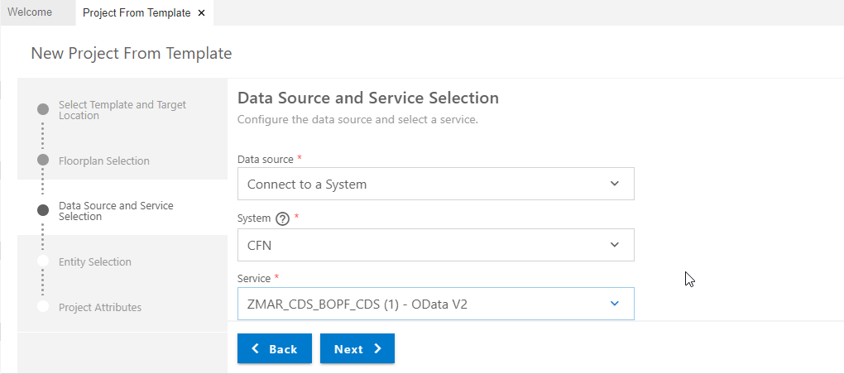
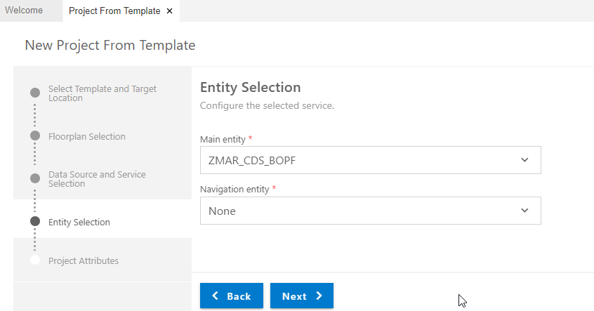
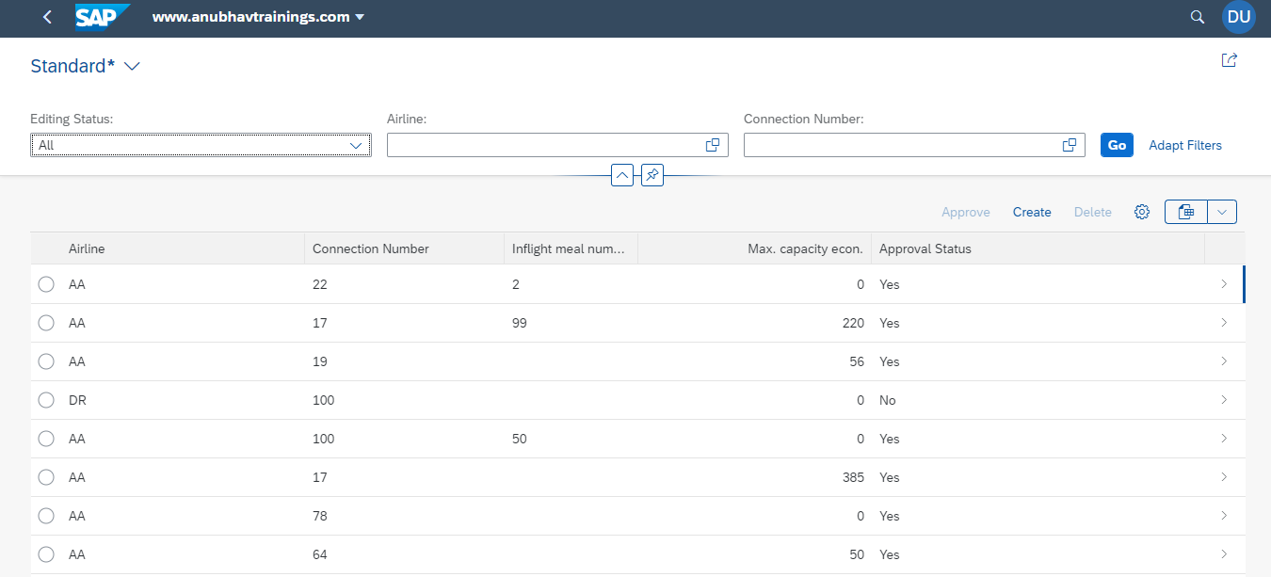
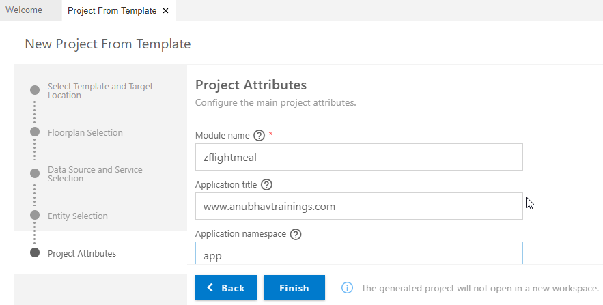
Create Fiori App with Template on BAS
Step 5. Enter Data Source & Select OData service.
Step 6. Entity Selection & Next.
Step 8. Run Project for Final output.
Step 7. Enter Project Attributes & Finish.

Slide 8
Gold Standard
In real-time application,
we bring statelessness to our application logic but our UI keeps on changing. Hence we separate the UI logic from business logic. Currently the UI logic is merged with app logic which create a risk when a developer change UI logic by mistake it can hamper the app logic.
When SAP develop an app using the same approach of annotations and deliver it to its customers and partners. What customers would need is to tweak the UI little bit.
Metadata Extension – is a new CDS artefacts which is developed to decouple the UI annotations from CDS view. SAP allows a layered approach, SAP deliver standard annotation code with layer #CORE and customers & partners can create another MDE file with layer #CUSTOMER or #PARTNER.
When app runs, it checks if there is #CUSTOMER annotation file, it will take highest prio and subsequently #PARTNER and #CORE.

Slide 9
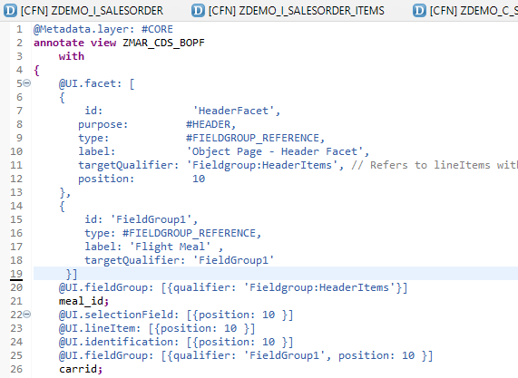
Meta Data Extension
A CDS metadata extension (MDE) extends a CDS entity with CDS annotations that are not defined in the CDS source code of the data definition. CDS metadata extensions can currently only be created for CDS views.
@Metadata.allowExtension: true
There can be several metadata extensions for one CDS entity. The following rules determine which metadata extension to use to evaluate the annotations:
Each metadata extension is assigned to a layer, such as branch, partner, or customer. The layer determines the priority of the evaluation.
A metadata extension can be joined to a CDS variant. The CDS variant can be specified during the evaluation of the annotations of a CDS entity to select the metadata extension.

Slide 10
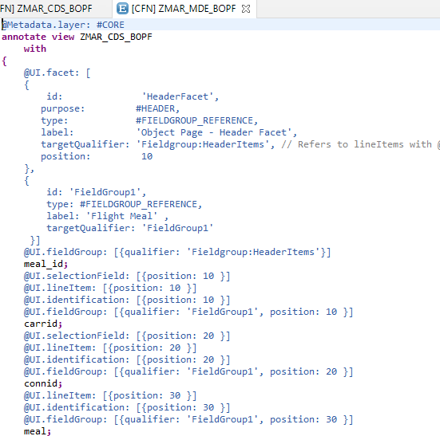
UI Annotations
Exercise :-
Metadata Extension Code for UI Annotation
Identification Annotation
Line item Annotation

Slide 11

End of Day 16
Trainer: Anubhav Oberoy

Slide 12

Trainer: Anubhav Oberoy

Slide 13
THANK YOU
If you cannot do
great things, do small things in a great way.
Anubhav Oberoy
https://www.anubhavtrainings.com

Slide 14


We’re committed to empower you to be
Most Desirable Resource
through powerful training solutions.
We build the workforce of the future.
250+
Corporate Clients
30,000+
Learners Trained
25000+
Learners Placed
FREE WEBINARS
Sign up for free webinars with industry experts every fortnight!
Enroll Now!
Contact us today!
https://anubhavtrainings.com/

Slide 15




More from AnubhavTrainings.com

